Slide 1
A complete guide to programming in c++
Chapter 4 – Input and output with streams

Slide 2
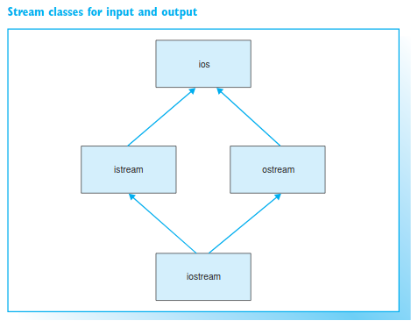
streams
The four standard streams are:
cin – object of class istream to control standard input
cout – object of class ostream to control standard output
cerr – object of class ostream to control unbuffered error output
clog – object of class ostream to control buffered error output

Slide 3
I/o stream classes
During the development of C++ a new class-based input/output system was implemented. This gave rise to the I/O stream classes, which are now available in a library of their own, the so-called iostream library.
The class ios is the base class of all other stream classes. It contains the attributes and abilities common to all streams.
Effectively, the ios class
manages the connection to the physical data stream that writes your program’s data to a file or outputs the data on screen
contains the basic functions needed for formatting data. A number of flags that determine how character input is interpreted have been defined for this purpose.

Slide 4
I/o stream classes
The istream and ostream classes derived from ios form a user-friendly interface for stream manipulation. The istream class is used for reading streams and the ostream class is used for writing to streams. The operator >> is defined in istream and << is defined in ostream, for example.
The iostream class is derived by multiple inheritance from istream and ostream and thus offers the functionality of both classes.

Slide 5
Standard streams
The streams cin and cout, which were mentioned earlier, are instances of the istream or ostream classes. When a program is launched these objects are automatically created to read standard input or write to standard output.
The other two standard streams cerr and clog are used to display messages when errors occur. Error messages are displayed on screen even if standard output has been redirected to a file.

Slide 6
Formatting and manipulators
When reading keyboard input, a valid input format must be used to determine how input is to be interpreted. Similarly, screen output adheres to set of rules governing how, for example, floating-point numbers are displayed. The stream classes istream and ostream offer various options for performing these tasks. For example, you can display a table of numeric values in a simple way.
In previous chapters we have looked at the cin and cout streams in statements such as:
cout << "Please enter a number: ";
cin >> x;

Slide 7
formatting
The following sections systematically describe the abilities of the stream classes. This includes:
The >> and << operators for formatted input and output. These operators are defined for expressions with fundamental types—that is, for characters, boolean values, numbers and strings.
manipulators, which can be inserted into the input or output stream. Manipulators can be used to generate formats for subsequent input/output. One manipulator that you are already familiar with is endl, which generates a line feed at the end of a line
other methods for determining or modifying the state of a stream and unformatted input and output.

Slide 8
Flags and manipulators
Formatting flags defined in the parent class ios determine how characters are input or output. In general, flags are represented by individual bits within a special integral variable. For example, depending on whether a bit is set or not, a positive number can beoutput with or without a plus sign.
Each flag has a default setting. For example, integral numbers are output as decimals by default, and positive numbers are output without a plus sign.
It is possible to modify individual formatting flags. The methods setf() and unsetf() can be used for this purpose. However, the same effect can be achieved simply by using so-called manipulators, which are defined for all important flags. Manipulators are functions that can be inserted into the input or output stream and thus be called.

Slide 9
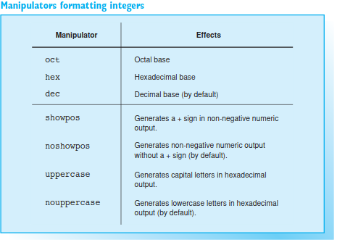
Manipulators formatting integers

Slide 10
Formatting options
The << operator can output values of type short, int, long or a corresponding unsigned type.
The following formatting options are available:
define the numeric system in which to display the number: decimal, octal, orhexadecimal
use capitals instead of small letters for hexadecimals
display a sign for positive numbers.
In addition, the field width can be defined for the above types. The field width can also be defined for characters, strings, and floating-point numbers, and will be discussed in the following sections.

Slide 11
Numeric system
Integral numbers are displayed as decimals by default. The manipulators oct,hex, and dec can be used for switching from and to decimal display mode.
cout << hex << 11; // output: b
Hexadecimals are displayed in small letters by default, that is, using a,b, ..., f. The manipulator uppercase allows you to use capitals.
cout << hex << uppercase << 11; //output: B
The manipulator nouppercase returns the output format to small letters.

Slide 12
Negative numbers
When negative numbers are output as decimals, the output will always include a sign. You can use the showpos manipulator to output signed positive numbers.
cout << dec << showpos << 11; //Output: +11
When octal or hexadecimal numbers are output, the bits of the number to be output are always interpreted as unsigned! In other words, the output shows the bit pattern of a number in octal or hexadecimal format.
cout << dec << -1 << " " << hex << -1; //output: -1 ffffffff

Slide 13
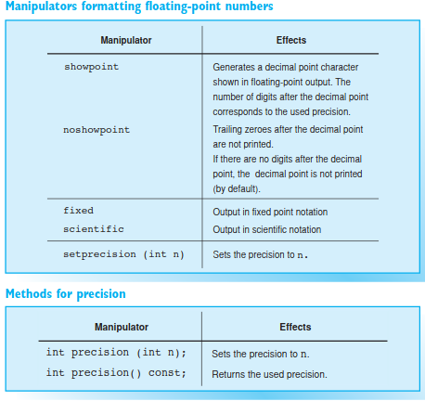
Manipulators formatting floating-point numbers
Floating-points are displayed to six digits by default.
Decimals are separated from the integral part of the number by a decimal point. Trailing zeroes behind the decimal point are not printed. If there are no digits after the decimal point, the decimal point is not printed (by default).

Slide 14
Standard settings
Examples:
cout << 1.0; // Output: 1
cout << 1.234; // Output: 1.234
cout << 1.234567; // Output: 1.23457
The last statement shows that the seventh digit is not simply truncated but rounded. Very large and very small numbers are displayed in exponential notation.
Example:
cout << 1234567.8; // Output: 1.23457e+06

Slide 15
formatting
The standard settings can be modified in several ways. You can
change the precision, i.e. the number of digits to be output
force output of the decimal point and trailing zeroes
stipulate the display mode (fixed point or exponential).
Both the manipulator setprecision()and the method precision() can be used to redefine precision to be used
Example:
cout << setprecision(3); // Precision: 3 or: cout.precision(3);
cout << 12.34; // Output: 12.3
Note that the header file iomanip must be included when using the manipulator setprecision(). This also applies to all standard manipulators called with at least one argument.

Slide 16
formatting
The manipulator showpoint outputs the decimal point and trailing zeroes. The number of digits being output (e.g. 6) equals the current precision.
Example: cout << showpoint << 1.0; // Output: 1.00000
However, fixed point output with a predetermined number of decimal places is often more useful. In this case, you can use the fixed manipulator with the precision defining the number of decimal places. The default value of 6 is assumed in the following example.
Example: cout << fixed << 66.0; // Output: 66.000000
In contrast, you can use the scientific manipulator to specify that floating-point numbers are output as exponential expressions.

Slide 17
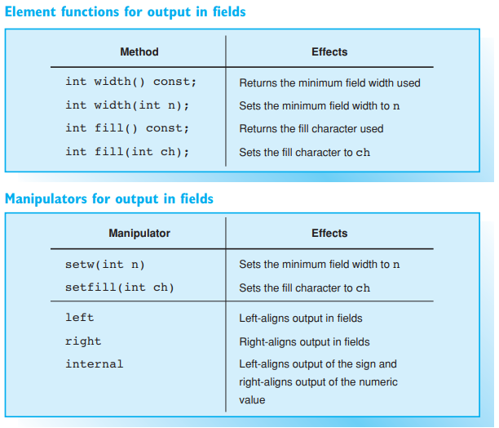
Output in fields
The << operator can be used to generate formatted output in fields. You can
specify the field width
set the alignment of the output to right- or left-justified
specify a fill-character with which to fill the field.

Slide 18
Field width
The field width is the number of characters that can be written to a field. If the output string is larger than the field width, the output is not truncated but the field is extended. The output will always contain at least the number of digits specified as the field width. You can either use the width() method or the setw() manipulator to define field width.
Example: cout.width(6); // or: cout << setw(6);
The default field width is 0. You can also use the width() method to get the current field width. To do so, call width() without any other arguments.
Example: int fieldwidth = cout.width();

Slide 19
Fill Characters and Alignment
If a field is larger than the string you need to output, blanks are used by default to fill the field. You can either use the fill() method or the setfill() manipulator to specify another fill character.
Example: cout << setfill('*') << setw(5) << 12; // Output: ***12
The fill character applies until another character is defined.
As the previous example shows, output to fields is normally right-aligned. The other options available are left-aligned and internal, which can be set by using the manipulators left and internal. The manipulator internal left-justifies the sign and right justifies the number within a field.
Example:
cout.width(6);
cout.fill('0');
cout << internal << -123; // Output: -00123

Slide 20
Output of characters, strings, and boolean values
The >> operator interprets a number of type char as the character code and outputs the corresponding character:
Example:
char ch = '0';
cout << ch << ' ' << 'A'; // Outputs three characters: 0 A
It is also possible to output the character code for a character. In this case the character code is stored in an int variable and the variable is then output.
Example:
int code = '0';
cout << code; // Output: 48
The '0' character is represented by ASCII Code 48.

Slide 21
Outputting strings
You can use the >> operator both to output string literals, such as "Hello", and string variables, as was illustrated in previous examples. As in the case of other types, strings can be positioned within output fields.
EXAMPLE
This example outputs the string "spring flowers??????". The manipulator right can be used to right-justify the output within the field.

Slide 22
Outputting boolean values
By default the << operator outputs boolean values as integers, with the value 0 representing false and 1 true. If you need to output the strings true or false instead, the flag ios::boolalpha must be set. To do so, use either the setf() method or the manipulator boolalpha.
Example

Slide 23
Formatted input
The >> operator, which belongs to the istream class, takes the current number base and field width flags into account when reading input:
the number base specifies whether an integer will be read as a decimal, octal, or hexadecimal
the field width specifies the maximum number of characters to be read for a string.
When reading from standard input, cin is buffered by lines. Keyboard input is thus not read until confirmed by pressing the key. This allows the user to press the backspace key and correct any input errors, provided the return key has not been pressed. Input is displayed on screen by default

Slide 24
Input fields
The >> operator will normally read the next input field, convert the input by reference to the type of the supplied variable, and write the result to the variable. Any white space characters (such as blanks, tabs, and new lines) are ignored by default.
EXAMPLE
An input field is terminated by the first white space character or by the first character that cannot be processed.
EXAMPLE
When reading strings, only one word is read since the first white space character will begin a new input field.
If "Lao Kai" is input, only "Lao" will be written to the city string. The number of characters to be read can also be limited by specifying the field width. For a given field width of n, a maximum of n–1 characters will be read, as one byte is required for the null character. Any initial white space will be ignored.

Slide 25
Formatted input of numbers - inputting integers
You can use the hex, oct, and dec manipulators to stipulate that any character sequence input is to processed as a hexadecimal, octal, or decimal number.
Example:
int n;
cin >> oct >> n;
An input value of 10 will be interpreted as an octal, which corresponds to a decimal value of 8.
Example: cin >> hex >> n;
Here, any input will be interpreted as a hexadecimal, enabling input such as f0a or -F7.

Slide 26
Inputting Floating-Point Numbers
The >> operator interprets any input as a decimal floating-point number if the variable is a floating-point type, i.e. float, double, or long double. The floating-point number can be entered in fixed point or exponential notation.
Example:
double x;
cin >> x;
The character input is converted to a double value in this case. Input, such as 123, -22.0, or 3e10 is valid.

Slide 27
Input errors
But what happens if the input does not match the type of variable defined?
Example:
int i, j;
cin >> i >> j;
Given input of 1A5 the digit 1 will be stored in the variable i. The next input field begins with A. But since a decimal input type is required, the input sequence will not be processed beyond the letter A. If, as in our example, no type conversion is performed, the variable is not written to and an internal error flag is raised. It normally makes more sense to read numerical values individually, and clear the input buffer and any error flags that may have been set after each entry.

Slide 28
Unformatted input/output - Reading and writing characters
You can use the methods get() and put() to read or write single characters. The get() method reads the next character from a stream and stores it in the given char variable.
EXAMPLE:
char ch;
cin.get(ch);
If the character is a white space character, such as a newline, it will still be stored in the ch variable. To prevent this from happening you can use cin >> ch; to read the first non-white space character

Slide 29
Reading and writing characters
The get() method can also be called without any arguments. In this case, get() returns the character code of type int.
Example: int c = cin.get();
The put() method can be used for unformatted output of a character. The character to be output is passed to put() as an argument.
Example: cout.put('A');
This statement is equivalent to cout << 'A'; , where the field width is undefined or has been set to 1.

Slide 30
Reading a Line
The >> operator can only be used to read one word into a string. If you need to read a whole line of text, you can use the global function getline(), which was introduced earlier
Example: getline(cin, text);
This statement reads characters from cin and stores them in the string variable text until a new line character occurs. However, you can specify a different delimiting character by passing the character to the getline() function as a third argument.
Example: getline(cin, s, '.');
The delimiting character is read, but not stored in the string. Any characters subsequent to the first period will remain in the input buffer of the stream

Slide 31
exercises
Formulate statements to perform the following:
Left-justify the number 0.123456 in an output field with a width of 15.
Output the number 23.987 as a fixed point number rounded to two decimal places, right-justifying the output in a field with a width of 12.
Output the number –123.456 as an exponential and with four decimal spaces.
Write a C++ program that reads any given character code (a positive integer) from the keyboard and displays the corresponding character and the character code as a decimal, an octal, and a hexadecimal on screen.

